Slide 1
Great Depression
Brother can you spare a dime?

Slide 2
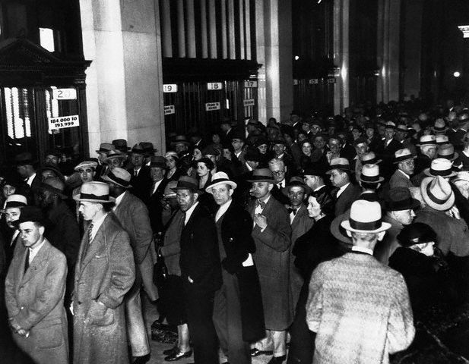
OBJ #1 - Describe the CAUSES and SPARK of the Great Depression. How did Overproduction affect both farmers and industry? What system collapsed and caused millions to lose their savings? Explain how buying on Margin created the Spark. How did people lose money because of the spark?
I. OBJ #1- Cause & Spark of the Depression
A. Causes of the Depression
  1. Overproduction, too much stuff (Factories and Farms)
a. Factory Workers begin to get layed-off
- Workers cannot buy goods, even more goods are overproduced
b. Farmers Can’t Survive
-low prices (can’t pay loans / make a living)
c. Supply & Demand- Prices Drop
2. Bank Failures
a. Banks close and loose $$$
b. People default on loans (Can’t pay Back)
c. Banks cannot cover their deposits, because it was lent out to bad creditors **5,000 banks close between 1929-1932**
d. People loose entire LIFE SAVINGS

Slide 3
1920’s Problems
Factories making Too Much, Farms growing too much
BANKS Have NO $$
PEOPLE LOST SAVINGS & JOBS
NO ONE TO HELP!
Factories Fire Workers (Don’t need them)
Farm Prices fall (Farmers can’t make $$)
Banks Close because they have no money: Loans have not been paid back, can’t give people their savings
Farmers & Factory Workers can’t pay back loans to Banks: DEFAULT!!

Slide 4
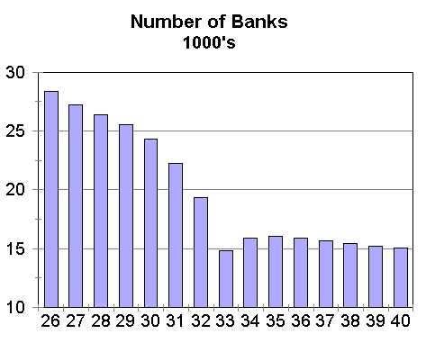
Banks have no money to give people
Banks Close
+
=
People Default on Loans
People Loose savings

Slide 5

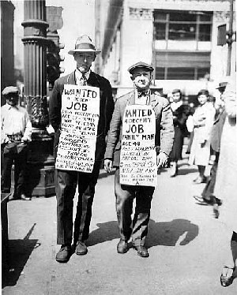
OBJ #1- Cause & Sparks of Depression
B. SPARK!!! Of the Depression
1. Stock Market Crash, Black Thur. Oct. 29, 1929
a. Summer 1929, Investors begin to sell stocks
b. Supply & Demand Again – Massive Sell-Off and prices begin to ______
2. How???
a. Buying on Margin (Borrowing $$)
- Buy stock by just paying a small portion of what the stock is worth
ex.- 100 shares at $10= $1000 only pay $300
still owe $700
-Problem, stock crashes and you loose your money and can’t payback stock broker
- stock broker can’t pay back bank

Slide 6
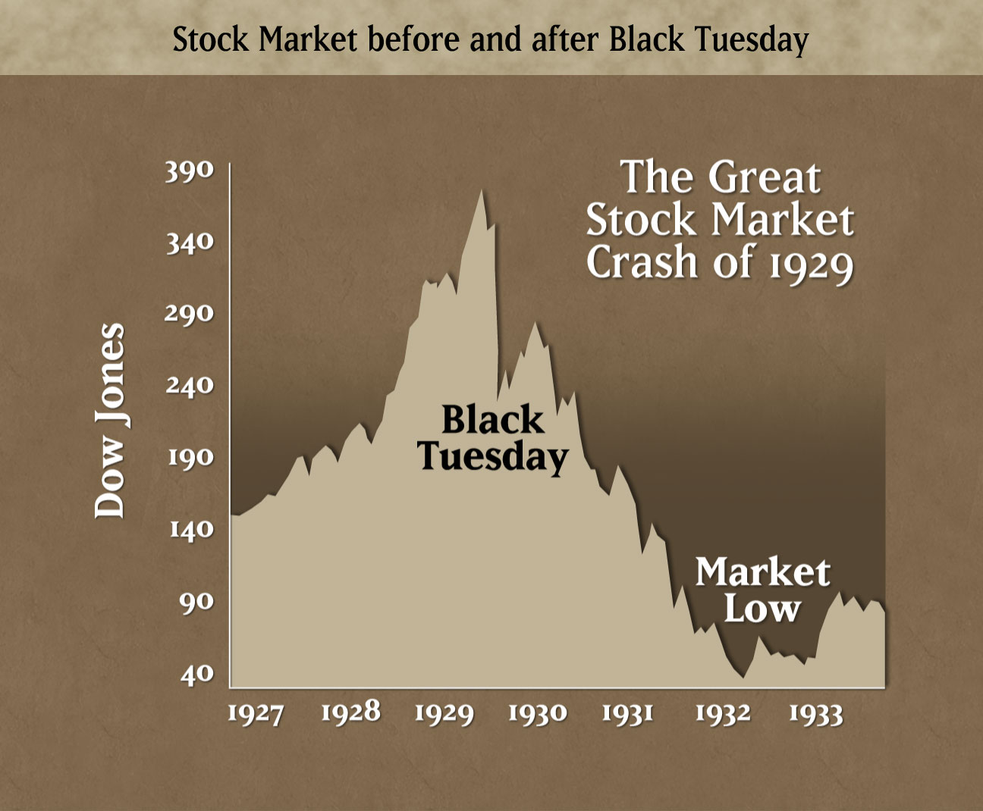

Slide 7
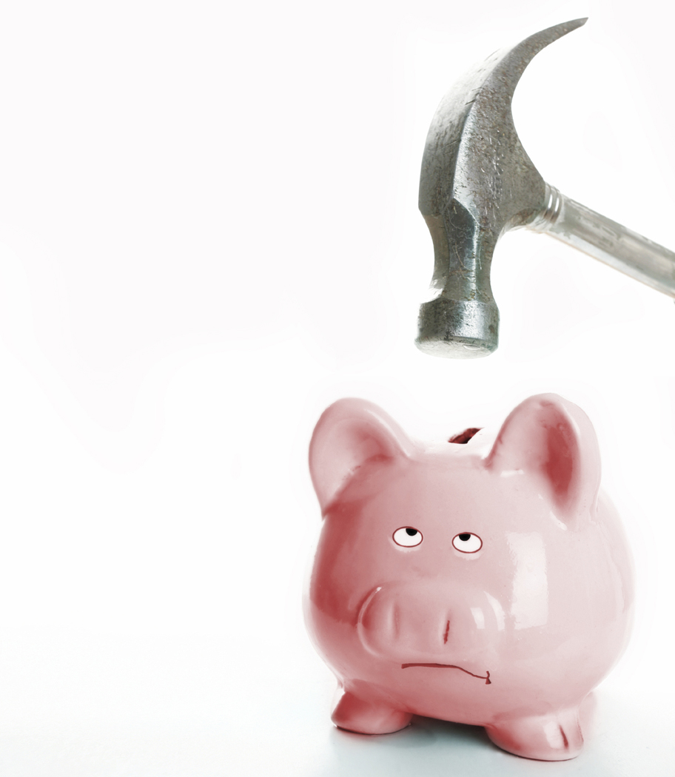
OBJ #1- Cause & Sparks of Depression
QUICK REVIEW:
Causes: 1. Overproduction
2. Bank Closings
Spark: 1. Stock Market Crash
Results: 1. Unemployment
2. Life Savings Lost
TOO MUCH STUFF!
BLACK TUESDAY

Slide 8
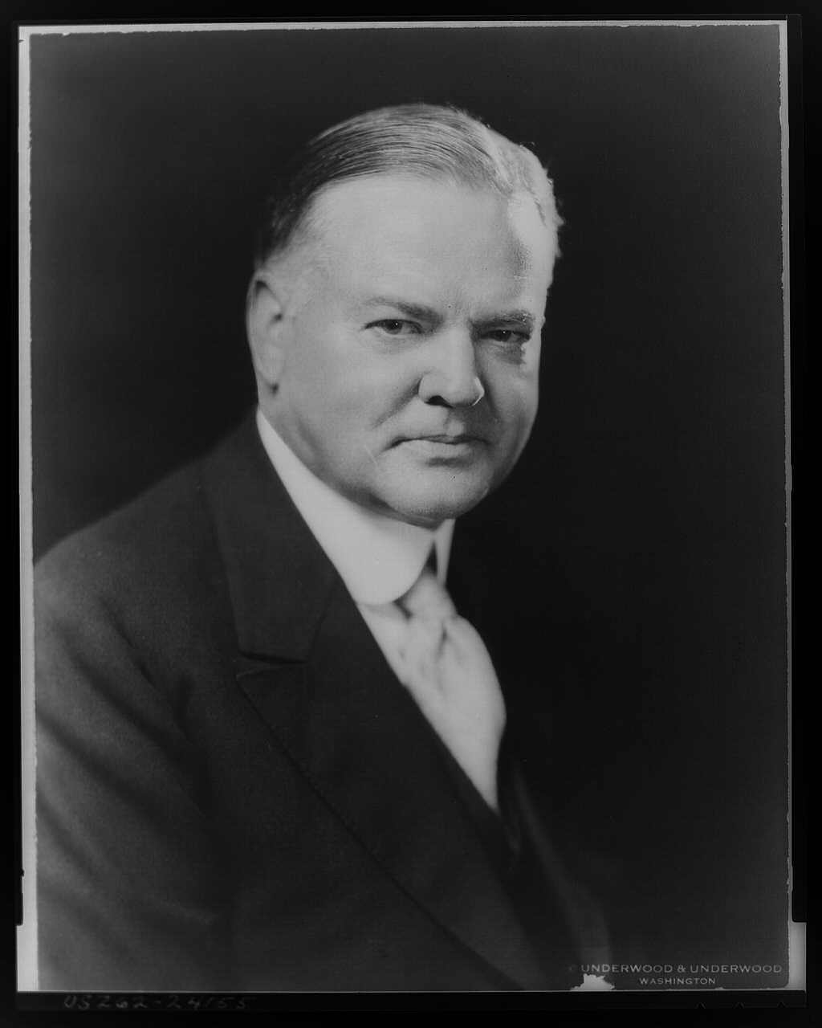
OBJ #2 -Describe how the Great Depression affected people. Who was the president when it started, and what did he do to help? Who tried to help the poor and what problems did they have? How did people try to escape the Great Depression?
II. OBJ. #2 – Affects of the Depression
A. Jobless / Homeless
1. 1930-1932 – Jobless goes from 4 to 12 million
2. Houses are lost, people become homeless
3. People are Desperate!!!!
B. Hatred for President Hoover
1. Say’s it is NOT Government’s job to fix the Poor
a. Say Churches and other groups should help
b. PROBLEM: People too poor to help churches so churches can’t help as much!!!
2. People name Poor Places after Hoover
a.*Hooverville- Shanty towns / Hoovermobile- cars pulled by mules
b. HOBOS- look for jobs*Hooverblankets- newspapers used as traveling the rails blankets by homeless

Slide 9
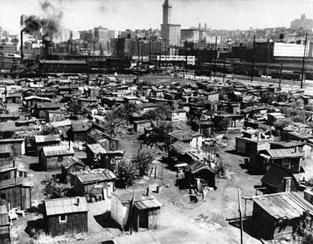
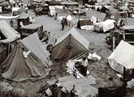
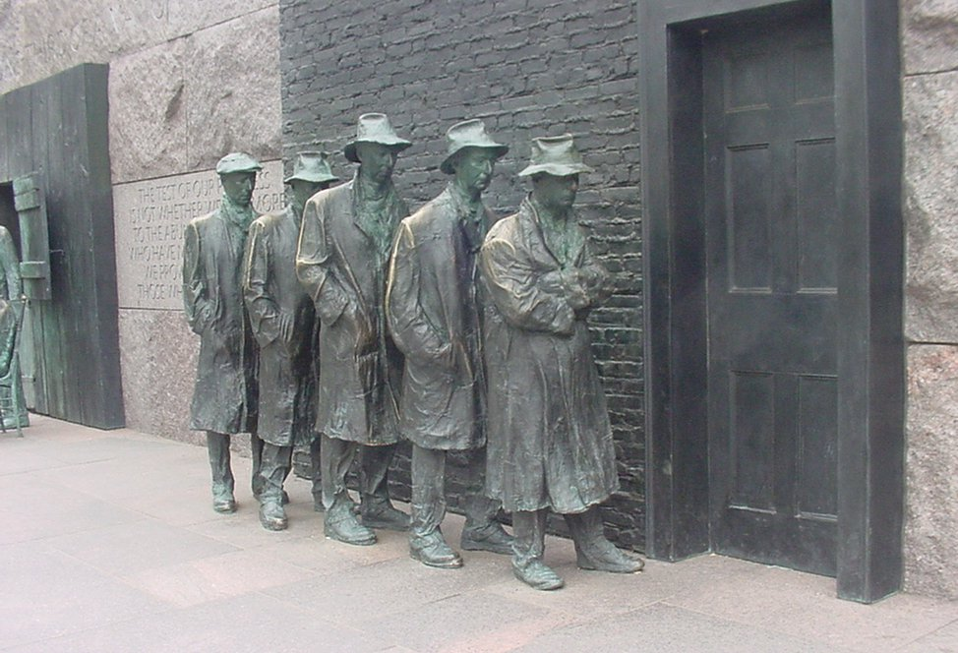
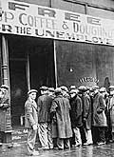
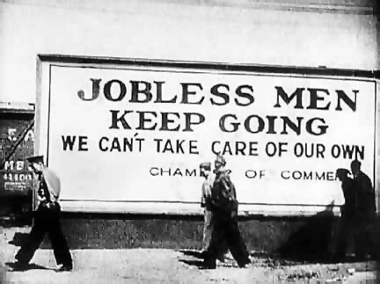

Slide 10
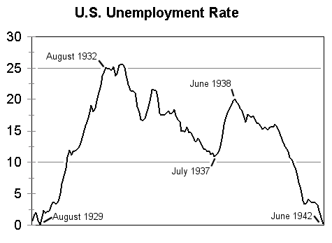

Slide 11
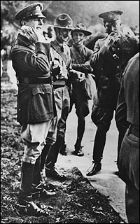

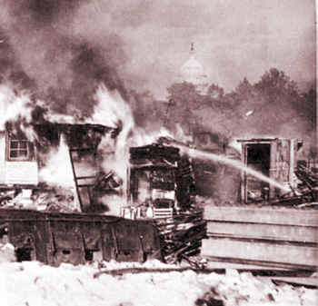
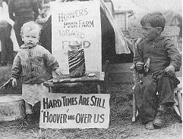
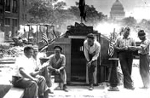
OBJ #2- Affects of the Great Depression
3. Bonus Army
a. WWI veterans who were promised a $ bonus in 1945,
* Veterans want it NOW (1932)
b. Veterans go to Washington and “camp out”
c. Hoover sends in Army (Eisenhower, MacArthur), used tear gas, machine guns, and burned the camp down

Slide 12
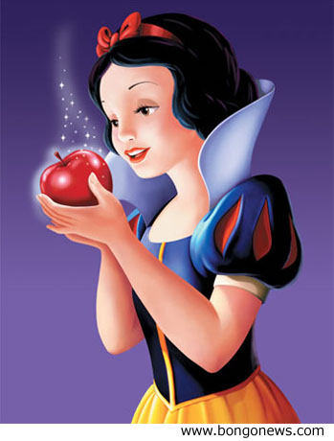
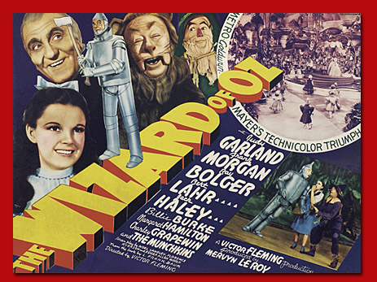
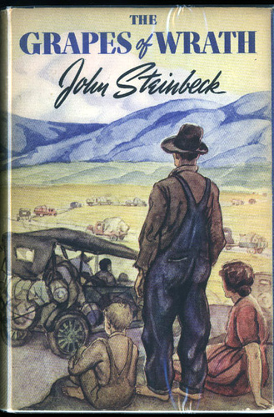
OBJ #2- Affects of the Great Depression
Wizard
C. Escaping the Depression
1. Radio- Comedies, Soap Operas
2. Movies- Shirley Temple, Child Actors
a. Snow White (first full-length animation)
b. Wizard of OZ
*Small girl escaping the Dust Bowl
3. Literature
a. Steinbeck, Grapes of Wrath
*About a family of ‘Okies’ escaping the Dust Bowl and how horribly they were treated
of
OZ

Slide 13
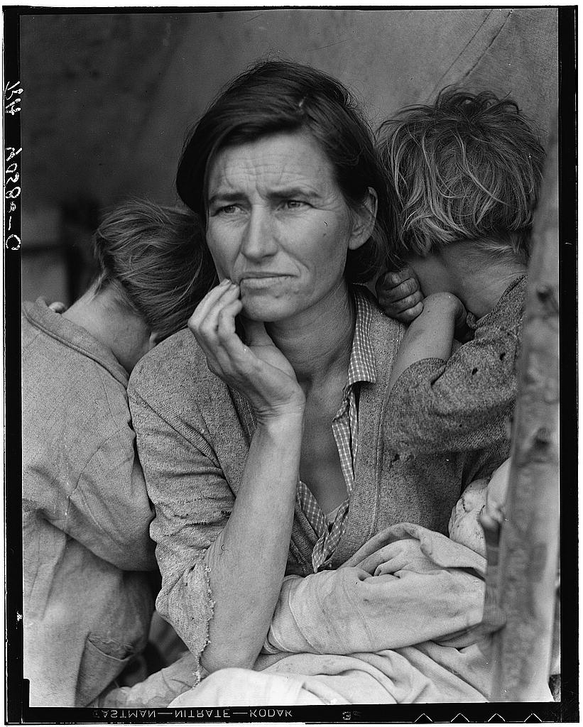
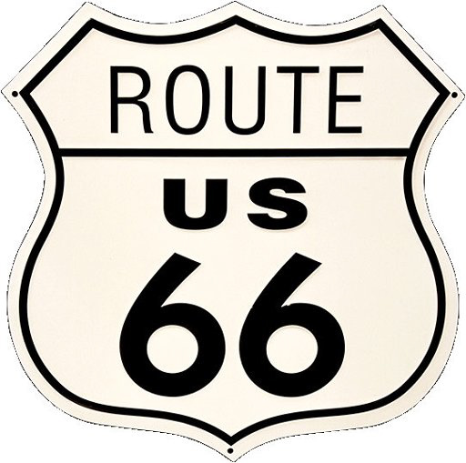
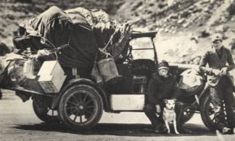
OBJ #3 - Describe the natural disaster that affected the U.S. during the Great Depression. What was the disaster’s nick-name? What caused the disaster? Where did the people go to try and escape their troubles and how were they treated (nick-names for these people)?
III. OBJ. #3- Natural Disaster “The DUST BOWL”
A. Great Plains suffers a huge Drought (1931)
1. Causes:
a. Drought . . .no rain
b. New technology, tractors and steel plows tear-up extra sod that was holding onto soil, drought turns open soil into sand box
  2. Huge Dust storms cover ‘Great Plains
B. Results
1. Can’t pay banks- Banks take Farms
2. Many Great Plains farmers move to California,
a. Try to get jobs on large farms
b. Treated poorly in Calif. -
*‘Oakies’ & ‘Arkies’-Not wanted in West

Slide 14
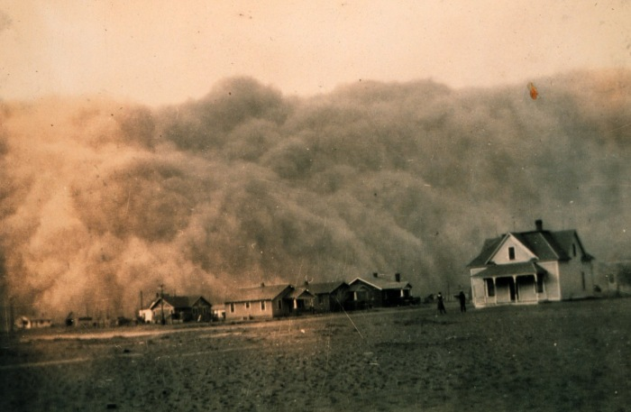
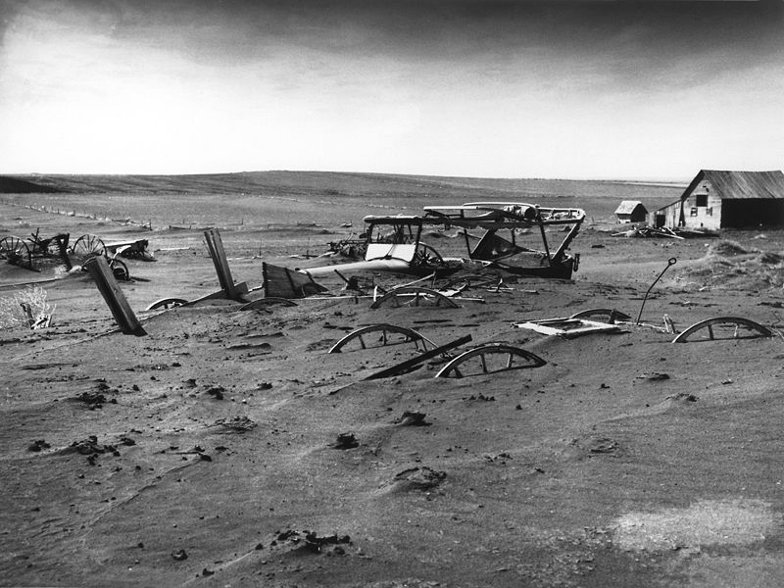
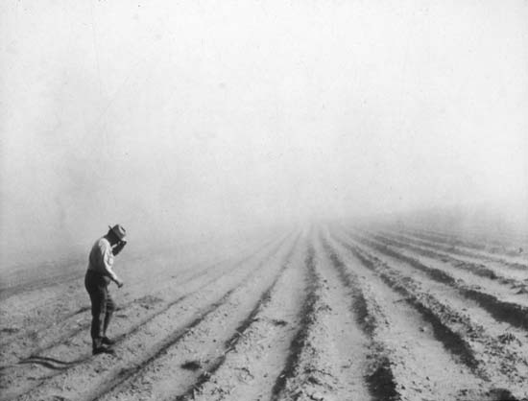
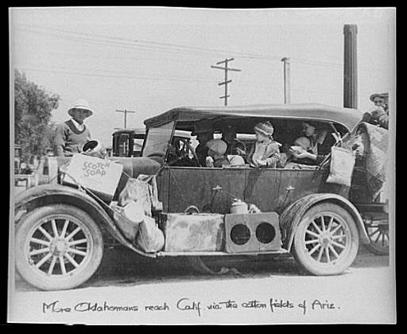

Slide 16
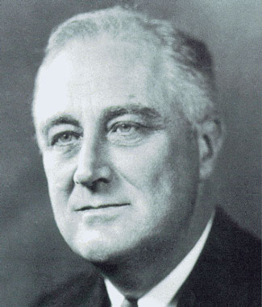
OBJ #4 - Describe Franklin Roosevelt’s approach to fixing the Great Depression. What problem did Roosevelt fix first and how? What was Roosevelt’s plan called? Name the three major goals of his plan?
IV. OBJ. #4 - The New Deal
A. President Roosevelt Elected (1932)
1. NY Reformer (Governor)
2. Brain Trust- Used professors and experts to develop programs to fight the depression
3. Promised “New Deal” for Americans
a. Experiment and change to fight Depression

Slide 17
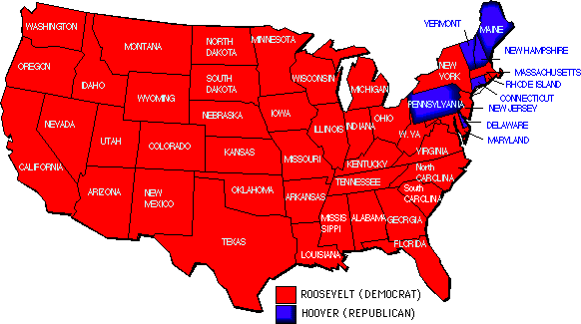
1932 Electoral College Votes

Slide 18
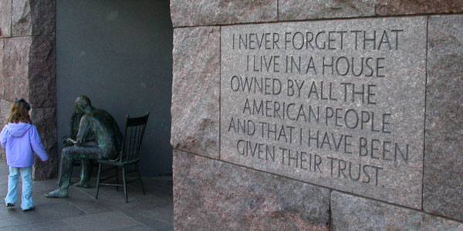
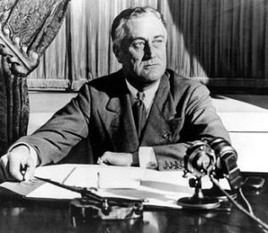
OBJ #4- Fixing the Depression “New Deal”
A. Fixing Banks!!!
1. Declared a banking crisis
a. Closed ALL banks/ 4 day “Bank Holiday”
b. Emergency Banking Relief Act- Passed by Congress, allowed only sound banks to reopen, the rest remained closed
2. Fireside Chat- told Americans by radio that the good banks were safer than $$ in a mattress
(30 more ‘chats’ that Am. listened to during his presidency)

Slide 19
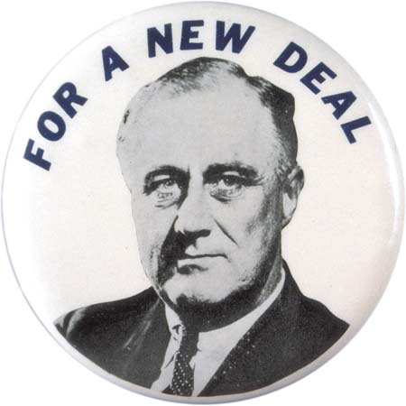
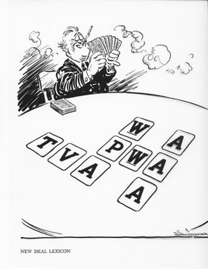
OBJ #4- Fixing the Depression “New Deal”
C. A NEW DEAL!!!
1. People Happy, Roosevelt sends bills to Congress
2. NEW DEAL BEGINS- 3 Goals:
a. Relief for Unemployed
b. Plans for Recovery
c. Reforms to Prevent more Depressions
3. Major New Deal Programs
a. Unemployment
*CCC- Civilian Conservation Corp
*PWA- Public Works Administration
*TVA- Tennessee Valley Authority
b. Recovery Plans
*NRA- National Recovery Act
*AAA- Agricultural Adjustment Admin.
c. Prevention Reforms
*FDIC- Federal Deposit Insurance Corporation
(Have you seen this?)
*SEC- Securities and Exchange Commision

Slide 20
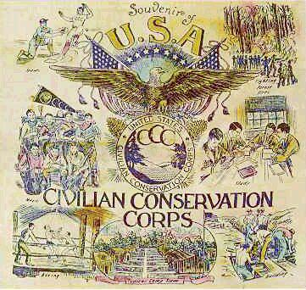
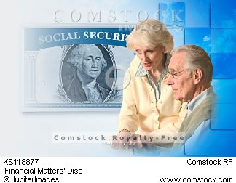

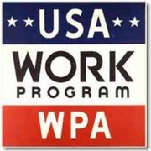
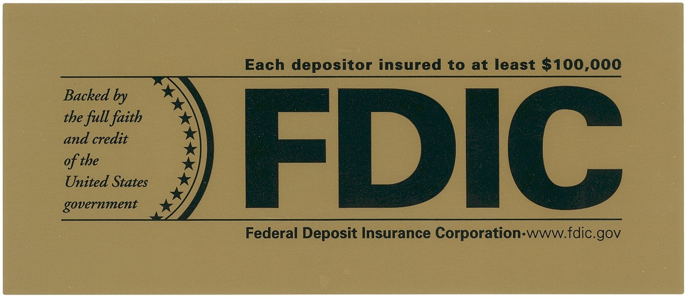
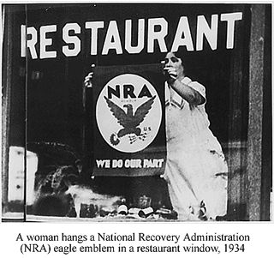

Slide 21
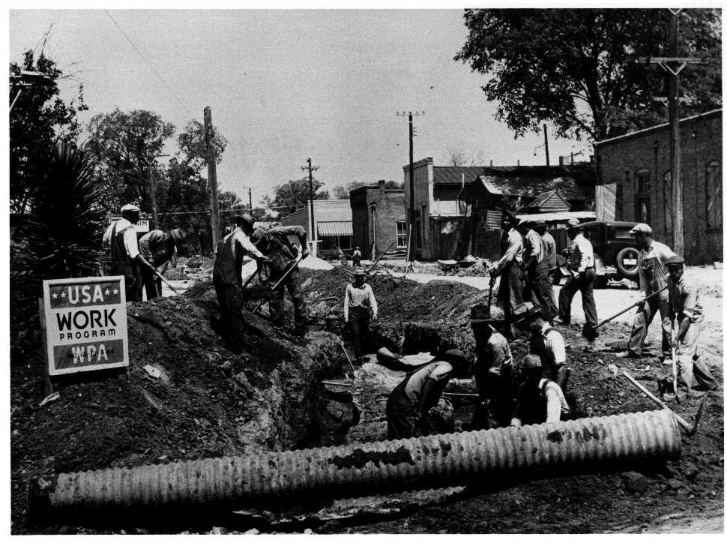

Slide 23
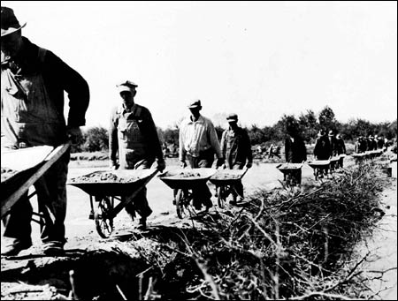
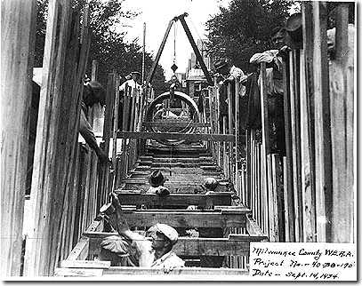
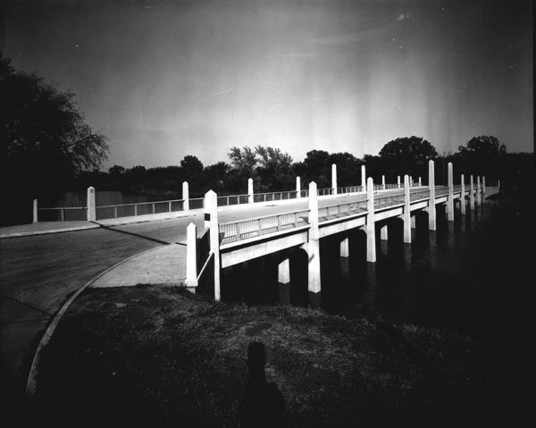
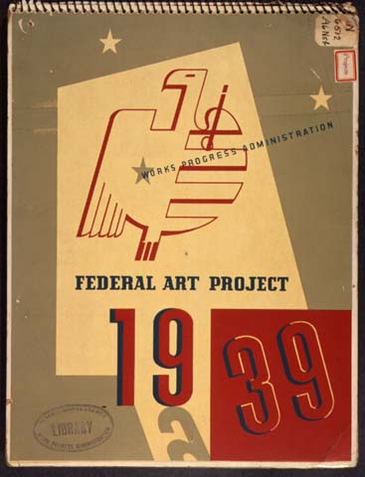
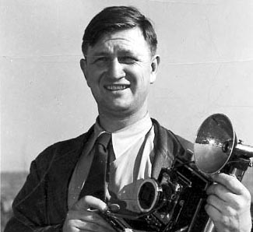
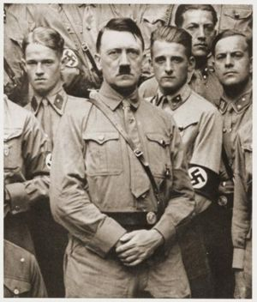
OBJ #4- Fixing the Depression “New Deal”
D. Results- Did NOT end the Depression
1. Most of the Businessmen disliked New Deal
2. Gave country confidence
a. Ended banking crisis
b. Helped with some Jobs
c. Infrastructure (buildings, schools, bridges, electricity, artwork)

Slide 24
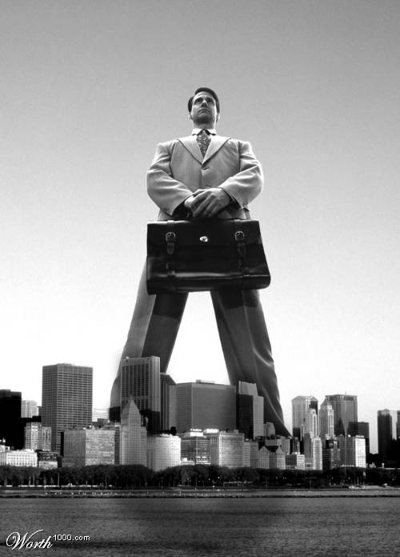
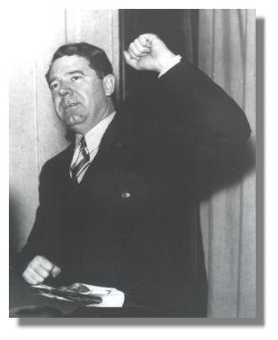
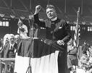
OBJ #5 - Describe the reasons people opposed Roosevelt’s plan. Give two (2) examples of people who opposed Roosevelt. Why? What did the Supreme Court say about the early part of the New Deal? How did Roosevelt try and change their minds? What was the result?
V. OBJ. #5 - Critics of the New Deal
A. BIG BUSINESS!!!! (Gov’t doing too much!)
1. Gov’t Can’t tell us what to do
B. FDR, not doing enough:
1. “Share Our Wealth”, Huey Long Gov. Louisiana
a. Heavy Tax on the wealthy
b. Give everyone- Home, Car, $$
c. Assassinated in 1935
2. Father Coughlin, “Radio Priest”
a. Mad at FDR for not being tough enough on big business
b. Hates communist, Unions, Jews (Hitler?)
3. Francis Townsend
a. Give pensions to anyone 60+, would get jobs to
younger people

Slide 25
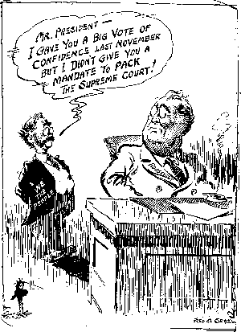
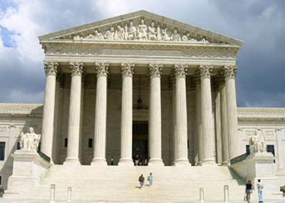
OBJ #5- Opponents of the New Deal (Against)
C. Supreme Court Reacts
1. 11 New Deal Plans Ruled Unconstitutional
2. Roosevelt Reacts: ‘Court Packing Scheme’
a. Wants Court raised from 9 to 15
-President chooses new judges
-New judges would favor New Deal
3. Friends & Enemies Very Upset!!!
a. FDR wants TOOO much POWER
b. Congress with all friends won’t pass
law for FDR
4. FDR Wins Anyway- By 1938 New Judges
a. 1 Justice switches, 1 Justice retires

Slide 26
This powerpoint was kindly donated to www.worldofteaching.com
http://www.worldofteaching.com is home to over a thousand powerpoints submitted by teachers. This is a completely free site and requires no registration. Please visit and I hope it will help in your teaching.

